Slide 1
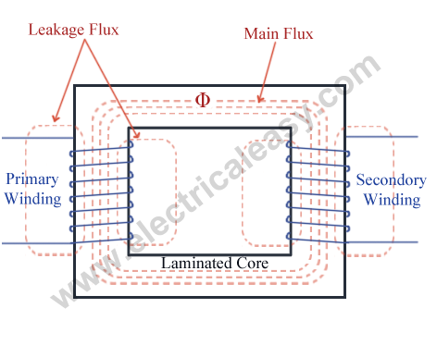
PERFORMANCE ANALYSIS OF SINGLE PHASE TRANSFORMER
MARPU JAGAN MOHAN (230002040) PIPPALA BHASKARA VENKATA PHANI (230002050)

Slide 2
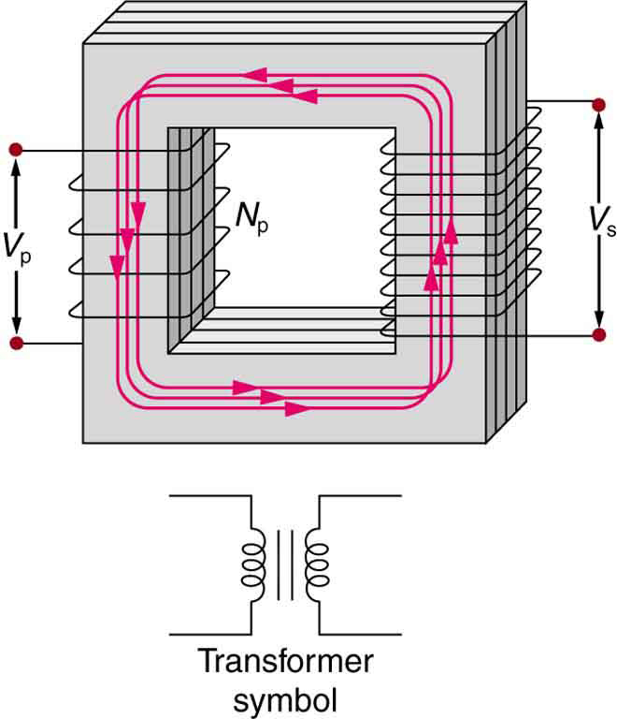
INTRODUCTION
Performance analysis of the single phase Transformer under different loading conditions , here we are going to show how the efficiency of the single phase transformer varies as the load on the secondary varies and we are going to show the analysis in the Matlab
Simulink. We are going construct a single phase transformer of Parameters:-
primary voltage = 155.56 RMS , frequency = 60hz , Rm = 1000 ohm , Lm is 2H , ratio of turns = 1:2
R_primary = 4 ohm, L_primary = 0.4H ,
R_ secondary =0.8 ohm, L_secondary = 0.08H,

Slide 3
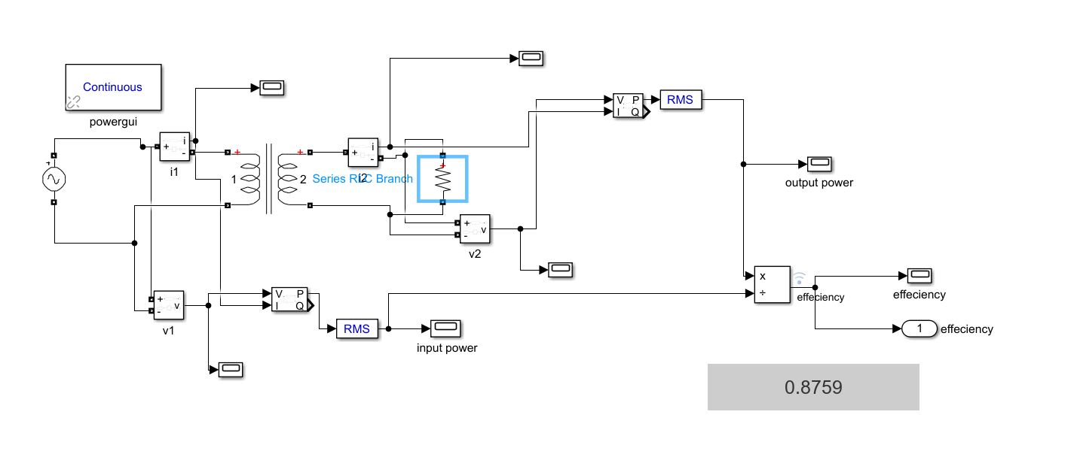
SIMULATIONS OVERVIEW
MODEL PREPARED IN THE SIMULINK
PARAMETERS ARE GIVEN IN THE PREVIOUS SLIDE (2)
SIMULATION METHODS USED:
Various simulation tools like MATLAB and MATLAB SIMULINK are employed to study transformer behavior under different load conditions. These tools allow for dynamic analysis.

Slide 4
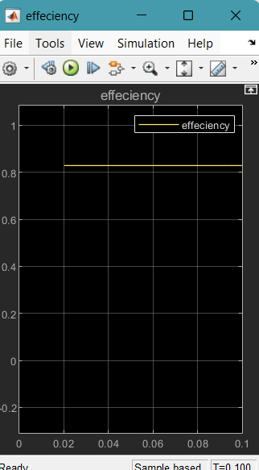
PERFORMANCE ANALYSIS
Here for the given circuit we are varying the load and observing the efficiency of the transformer
LOAD (OHM) | EFFIECIENCY
100 | 0.8283
200 | 0.8728
300 | 0.8756
400 | 0.8674
500 | 0.8551
600 | 0.8410
700 | 0.8264
800 | 0.8115
900 | 0.7967
1000 | 0.7822
1100 | 0.7679
1200 | 0.7540
1300 | 0.7406
FOR R=100 OHM

Slide 5
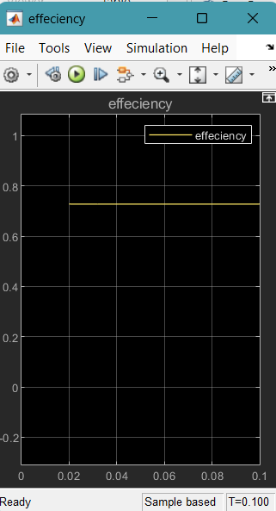
1400 | 0.7275
1500 | 0.7147
1600 | 0.7024
1700 | 0.6905
1800 | 0.6789
1900 | 0.6677
2000 | 0.6568
2100 | 0.6462
2200 | 0.6360
2300 | 0.6261
2400 | 0.6164
2500 | 0.6071
2600 | 0.5991
2700 | 0.5911
2800 | 0.5824
FOR R = 1400 OHM

Slide 6


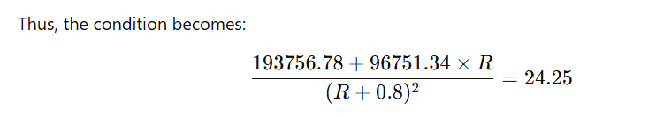
REASONS FOR THE OUTCOMES:
Here we observe that the efficiency is increased from initial 100 to 235 ohm and then gradually decreased from there to 2700 ohm , as the we know that the efficiency of the transformer is maximum when the coreloss =copperloss, here we considered the magnetizing resistance as 1000 ohm and the reactance as 2H, so there will be some core losses, by using the equivalent diagram and other parameters , upon calculating we get
Now for some load R we get the copper losses by using the given parameters is
By solving we get R = 265 ohm it means efficiency will be maximum for this load
Now by equating both copper losses and the core losses

Slide 7
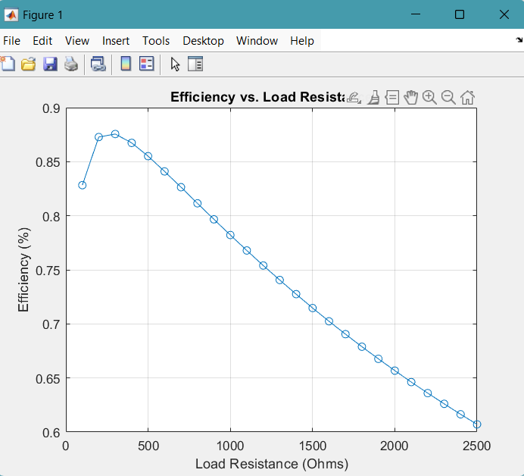
BY PLOTING OUTCOMES IN MATLAB -
Here is the final outcome , we can clearly observe that the efficiency is gradually decreasing by increasing the load from 300 to 2500 ohm, we can also see that the efficiency is maximum at the R= 265 ohm, at this it is actually where the corelosses are equal to copperlosses, at that particular point efficiency is maximum.

Slide 8
CONCLUSION
We can conclude that in order to utilize transformer with the high efficiency then we have to select a optimum load around the maximum point (265 ohm) for good performance. It was verified using the equivalent circuit diagram. So for every transformer there will be a small range of load where the transformer works with high frequency.

